Slide 1
Unit 6
Halftoning shading Transparency

Slide 2
Halftoning

Slide 3
Halftoning is the process of printing continuous tone images in newspapers, magazines and books using a bi-level printer.
In the case of black & white printing, one can’t directly print lots of shades of grey using only pure black ink on a printing press.
What it does is, create a dot pattern by exposing a negative through a fine screen onto a photosensitive printing plate.
The size of the dots varies depending on the fineness of the screen and the length of exposure.

Slide 4
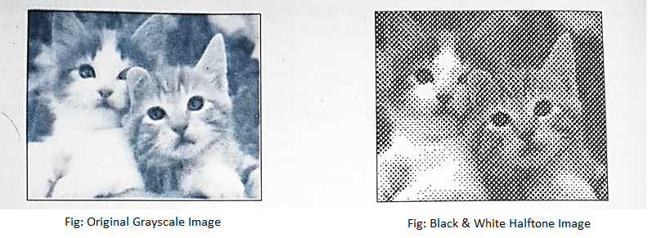

Slide 5
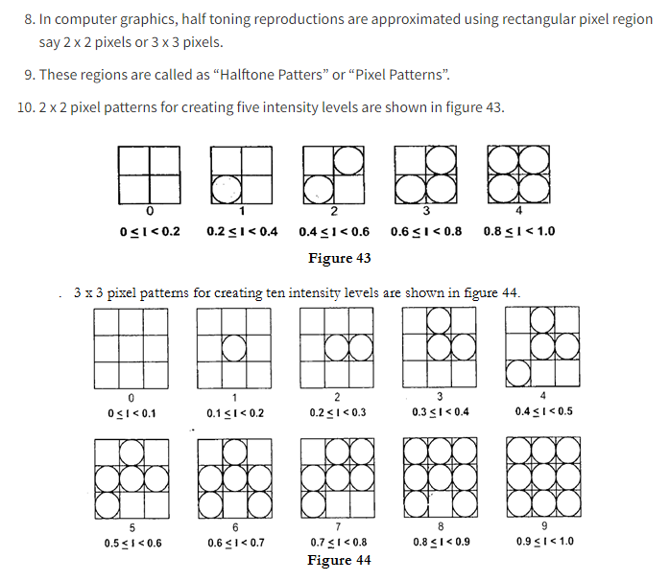

Slide 6
In areas where the images were dark, the plate would print large dots of ink, so large and dense that the dots may even overlap.
In areas where the image was light, only the smallest dispersed dots of ink are printed.
The dots fuse, both on the paper and in our eyes, to give a convincing illusion of continuous tones.
Such printed images made up of a series of varying sizes & varying density dots in a specific pattern to simulate the look of continuous tones are commonly known as Halftones.

Slide 7
The colour halftones are made up of a series of dots in cyan, magenta, yellow and black (CMYK) that fool the eye into seeing the millions of colours that make up the original Image.

Slide 8
What Does Halftone Mean?
Halftone is a graphic design technique used to reproduce an image by using dots of varying length with one or more colors.
It enables image display similar to a continuous tone-like image but on a pixelated or halftone background.

Slide 9
Halftone is a type of static visual effect applied on digital and print images.
It works on a very simple principle, where each pixel in an image area is considered a dot with different sizes, some of which take up more space than one pixel.
When a picture/image is converted to halftone, the image texture appears as if it has been pasted on top of a collection of infinite but non-continuous dots.
The dots are actually not unlimited but equivalent to the image's total resolution. The resulting image/picture is known as a halftone image.

Slide 10
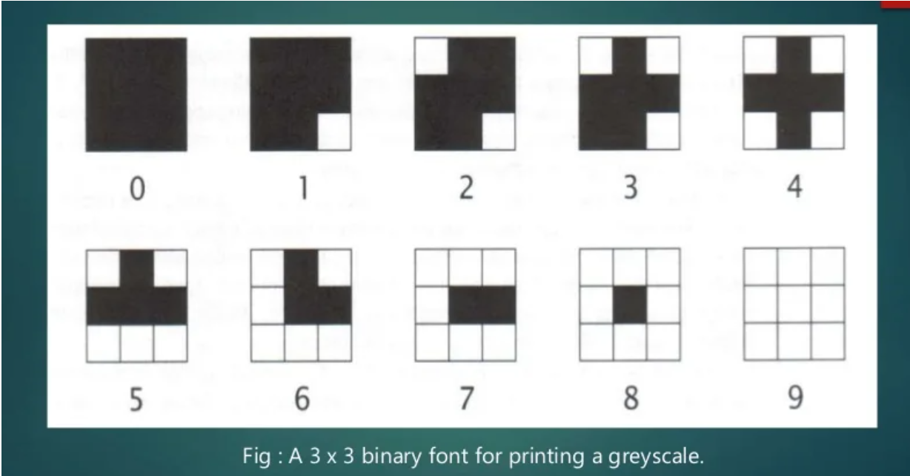

Slide 11
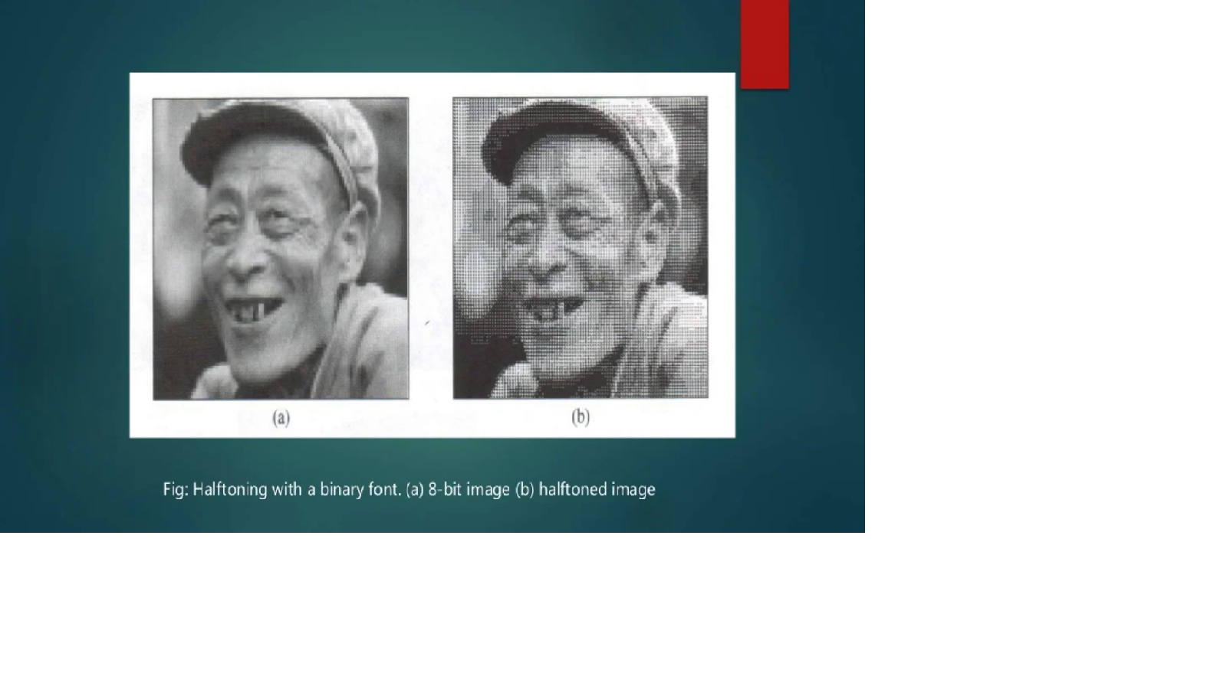

Slide 12
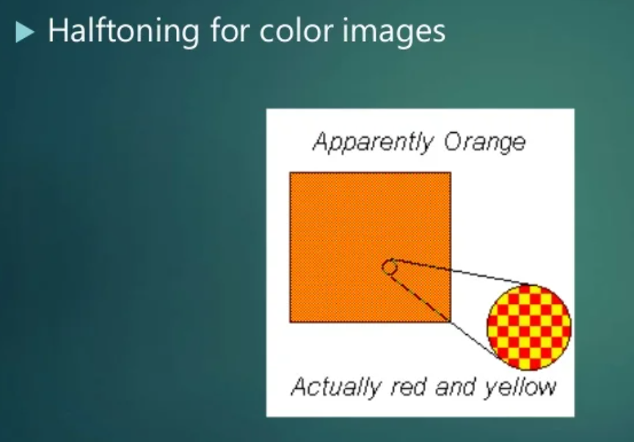

Slide 13
Dithering

Slide 14
Dithering:
It is an effect that is used in many different places, including regular 2D graphics and also in printing. In 3D, It is used largely to show more realistic colours without needing to increase the colour depth of the image.

Slide 15
To represent real-world objects on a computer screen, we need to have a “True Color” graphics system capable of displaying 16777216 (16 million) different colours.
But when not so many different colours are available in the system.
This technique may be adopted to render images with colours that are apparent, non-existing actually.
These techniques are known as Dithering.
It is used in computer graphics to create the illusion of additional colours on a colour display or printer.

Slide 16
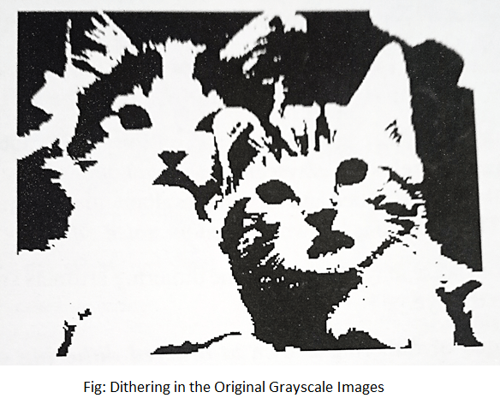

Slide 18
Transparency

Slide 19
Transparency in computer graphics is actually an illusion.
Ultimately, every pixel on the screen has a fixed, solid colour.
But if we calculate a colour based on contributions from two logical objects that are overlapping, the illusion of the front object having some transparency can be achieved.

Slide 20
Computer graphics is based on the “painter’s algorithm”. This is a simple concept, that starts with a blank “canvas”, and draws on its surface. Anything that is drawn later overwrites anything that was there before - just like applying paint.

Slide 21
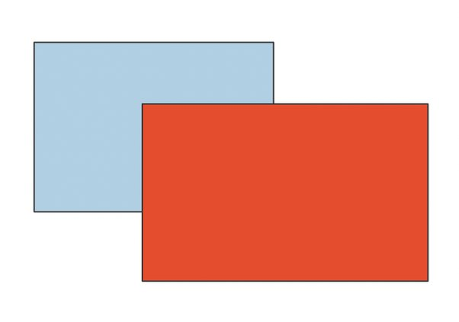

Slide 22
Here for example, the blue rectangle was drawn first, then the red rectangle, which completely overwrites any formerly blue pixels, replacing them with red ones.
But instead of totally replacing an existing pixel, the value can be calculated based on the colour of the new pixel and the value that is there already. For example, the colour could be the average of the two pixel values.

Slide 23
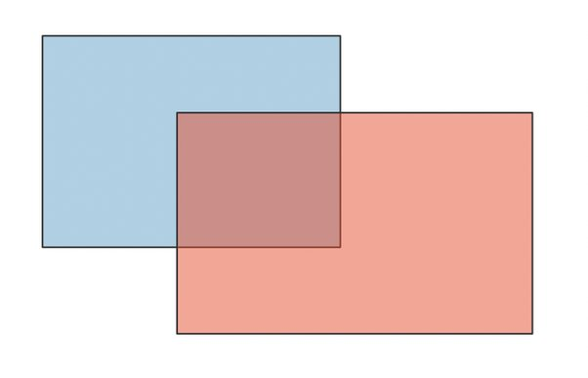

Slide 24
Here, the red colour is averaged with pixels that are there already. These are both the white “background” pixels and the blue pixels of the blue rectangle.
This creates a pretty convincing illusion that the red rectangle is partially transparent, letting through images “behind” the shape.
But in reality the pinkish tinged pixels are just as solid as the white or blue ones.

Slide 25
In order to control this process, each pixel value in the image to be rendered actually has four components. It has the three R, G and B levels that determine its colour, but also an “alpha” value that indicates how the background and foreground pixels are to be combined.
When the new pixel colour is computed, it takes the alpha value and uses it to blend some proportion of the existing pixel and the new pixel component. If the alpha value is small, a much greater proportion of the existing pixel contributes, If it is large, more of the new pixel is used.

Slide 26
Some example images for u

Slide 27
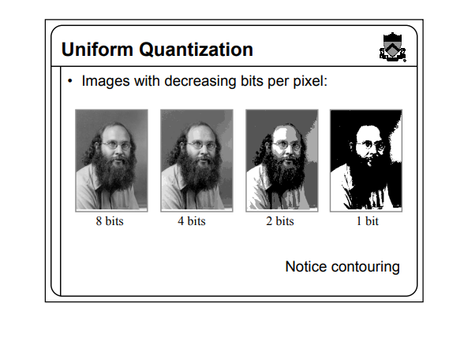

Slide 28
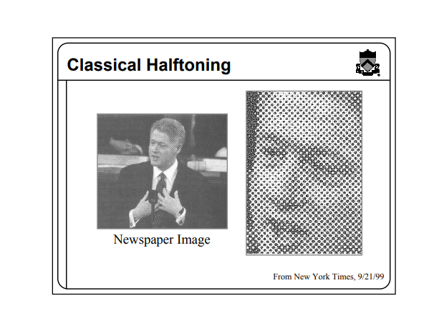

Slide 29
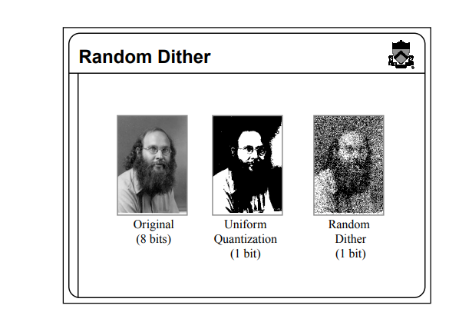

Slide 30
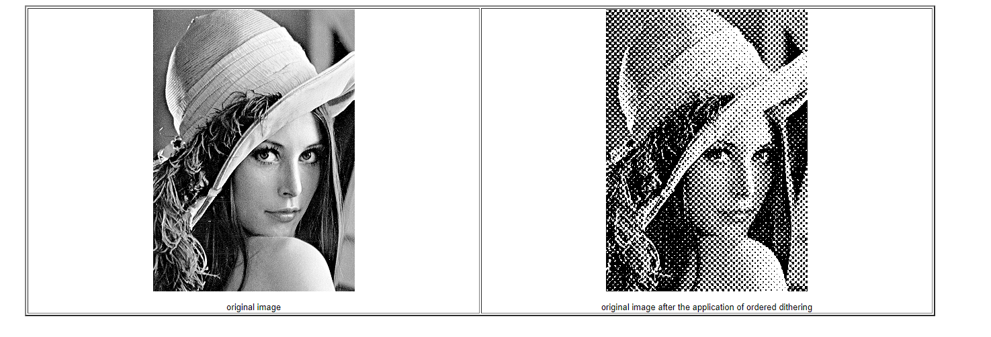

Slide 31
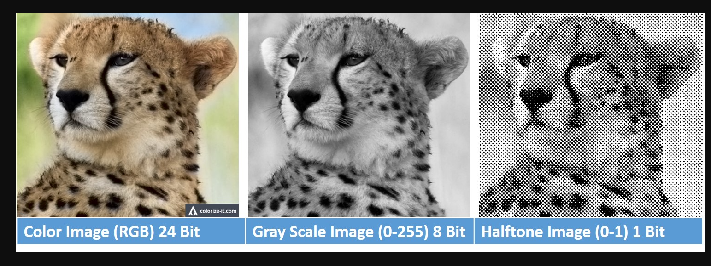

Slide 32
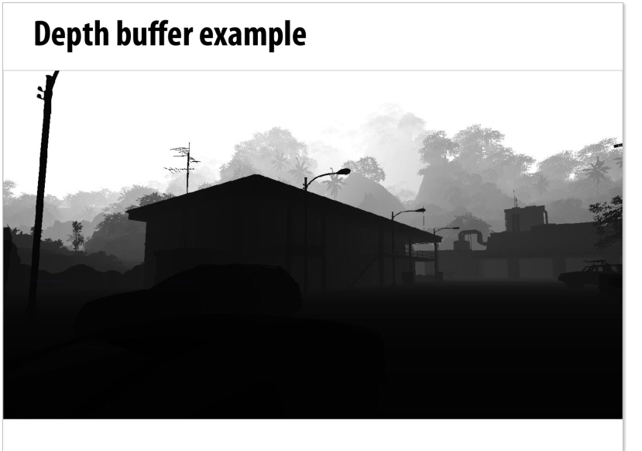

Slide 33
ALL the Very best

